Slide 1
Data Structures and Algorithms -3 (25CS2103E)
RouteOpt: A Data-Cleaning and Approximation Engine for Capacitated Multi-Vehicle Route Optimization with Time Windows
Team Members
Sai Rohit (252009091)
Surendra (2520090142)
Akash (2520090127)
Under the Esteemed Guidance of
Assistant Professor, Dr. Dyuti Banerjee, AI - DS

Slide 2
Contents
Abstract
Introduction
Literature Survey
Problem Statement and Objectives
Proposed Methodology / System Architecture
System Design / Workflow
Final Implementation
Implementation Modules
Algorithm / Method Used
Source Code / Key Code Snippets
Testing and Validation
Experimental Results / Output Screenshots
Performance Analysis
Discussion
Conclusion
Future Scope
References

Slide 3
Abstract
The problem addressed is the Capacitated Vehicle Routing Problem with Time Windows (CVRPTW), which is NP-hard and difficult to solve exactly for large fleets.
Real-world logistics require fast approximation methods rather than exact solvers.
The project introduces RouteOpt, a routing engine that:
Ingests raw stop and address data
Cleans, standardizes, and geocodes messy addresses
Deduplicates repeated stops
Clusters and assigns stops to vehicles while respecting capacity constraints

Slide 4
Introduction
The core topic is the Vehicle Routing Problem (VRP) - a generalization of the Traveling Salesman Problem to multiple vehicles.
VRP is central to combinatorial optimization and logistics planning.
Practical variants include:
CVRP - adds vehicle capacity limits.
CVRPTW - adds delivery time windows for customers.
These variants are widely used in delivery, field-service, and transportation
operations.
Exact optimization methods (branch-and-bound, integer linear programming)
guarantee optimal solutions but do not scale beyond a few dozen stops.
Industry systems rely on heuristics and metaheuristics to get near-optimal
solutions quickly:
Constructive heuristics: nearest-neighbor, Clarke-Wright savings.
Local/metaheuristic search: 2-opt, Or-opt, simulated annealing, tabu search.

Slide 5
Literature Survey
Vehicle Routing Problem (VRP): Research mainly focuses on finding efficient routes for vehicles while serving multiple customers.
Capacitated VRP (CVRP): Existing methods consider vehicle capacity constraints
to ensure that vehicle load does not exceed its maximum capacity.
Time Window Constraints: VRPTW approaches ensure that customers are served
within their specified time windows, making route planning more realistic.
Heuristic & Approximation Methods: Techniques such as Greedy, 2-opt, Genetic Algorithms, and Ant Colony Optimization are used to obtain good solutions with less computation time.
Research Gap: Many existing systems focus mainly on route optimization, while RouteOpt integrates data cleaning, validation, capacity constraints, time windows, and approximate multi-vehicle routing into a unified system.

Slide 6
Problem Statement and Objectives
Real-world delivery datasets often contain missing, duplicate, inconsistent, or invalid data, which can affect route planning.
Planning routes for multiple vehicles becomes complex when vehicle capacity
constraints must be satisfied.
Customers may have specific time windows, requiring vehicles to arrive within a
given time period.
Traditional exact optimization methods can become computationally expensive for
large numbers of customers and vehicles.
There is a need for a system that cleans and validates input data before performing
route optimization.
Therefore, RouteOpt aims to provide an efficient approximation engine that generates feasible and optimized multi-vehicle routes while considering vehicle capacity and customer time-window constraints.

Slide 7
Software and Hardware Requirements
Software Requirements
The system operates on 64-bit Windows, macOS, or Linux. The backend uses Python 3.9+ with FastAPI, Pandas, and Geopy for data cleaning, geocoding, and heuristics. The frontend runs on React.js with Leaflet.js for mapping, supported by a PostgreSQL or MySQL database.
Hardware Requirements
Minimum specs need an Intel i5, Ryzen 5, or Apple M1 CPU with 8 GB RAM and 10 GB SSD space. Recommended specs require an Intel i7, Ryzen 7, or Apple M2 CPU with 16 GB RAM and 25 GB SSD space to run local-search heuristics smoothly

Slide 8
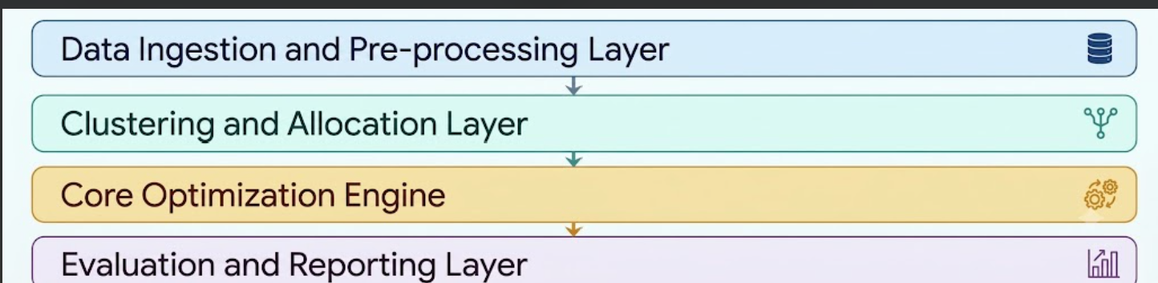
Proposed Methodology / System Architecture

Slide 9
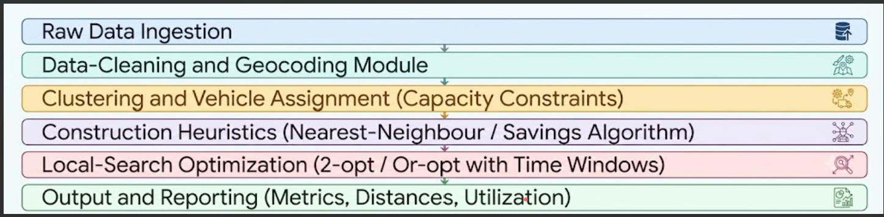
System Design / Workflow

Slide 10
Final Implementation
Project Setup
Development environment: Java, Python, React, and FastAPI.
Tools and technologies used: Java, Python, FastAPI, React, Docker.
Project folder structure: realtime_route_optimizer/
Data Collection / Dataset Preparation
Dataset source: Solomon Benchmark, OpenStreetMap, Kaggle datasets.
Data format: CSV, JSON, and spatial matrices.
Data preprocessing: Cleaning, geocoding, and matrix generation.

Slide 11
System Implementation
Main modules: Preprocessing, clustering, routing, and analytics.
Input processing: Ingesting, validating, geocoding, matrix construction.
Core algorithm/model: Clustering, Clarke-Wright, and 2-Opt solvers.
Output generation: Optimized routes, metrics, and alerts.
Algorithm Implementation
Algorithm steps:
Preprocessing & Distance Matrix Calculation
Spatial Clustering & Fleet Partitioning
Baseline Route Construction
Path Optimization & Local Search
Time Window & Constraint Validation

Slide 12
Final Implementation – Algorithm Implementation - Pseudocode
FUNCTION RouteOpt(raw_stops, capacity, depot):
stops = CleanAndGeocode(raw_stops)[cite: 1]
clusters = ClusterByCapacity(stops, capacity)[cite: 1]
FOR EACH cluster IN clusters DO
route = BuildSavingsRoute(cluster, depot)[cite: 1]
route = Optimize2OptWithTimeWindows(route)[cite: 1]
fleet_routes.Append(route)
END FOR
RETURN ReportMetrics(fleet_routes)[cite: 1]

Slide 13
Final Implementation – Algorithm Implementation – Important Parameters
Vehicle Constraints & Route Planning Parameters
Vehicle Capacity: Limits on load/volume assigned per vehicle.
Time Windows: Specific delivery/arrival time windows required for each stop.
Stop Data: Raw stop locations, messy addresses (requiring standardization and geocoding), and duplicate entries.

Slide 14
Algorithms & Optimization Pipeline
Construction Heuristics: Nearest-Neighbor Algorithm and Savings Algorithm.
Local-Search Improvement: 2-opt and Or-opt heuristics.
Key Performance Metrics (Outputs)
Total Distance: Overall travel distance across generated routes.
Estimated Travel Time: Total calculated travel time per route.
Vehicle Utilization: Capacity efficiency per deployed vehicle.
Time-Window Violations: Count/severity of missed or late delivery windows.
Computation Time vs. Solution Quality: Performance benchmark compared against exact solvers.

Slide 15
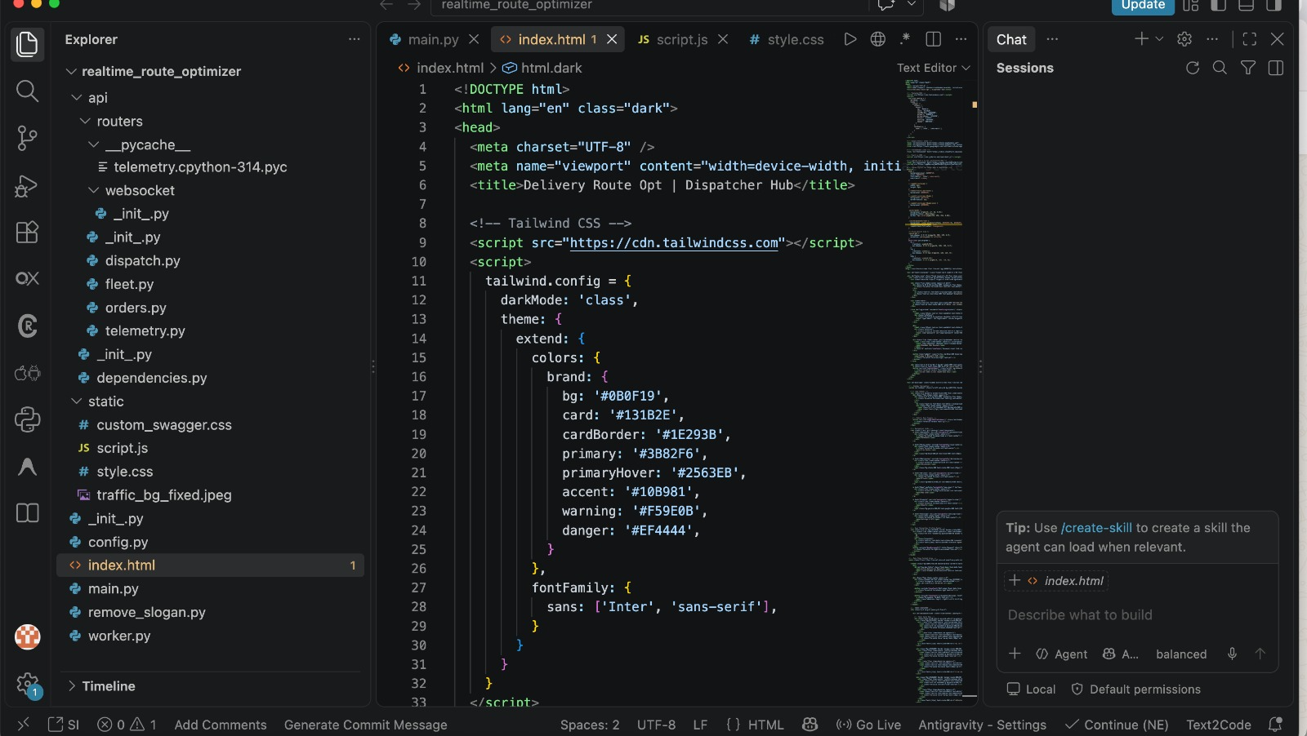
User Interface / Application Implementation – Main Screen

Slide 16
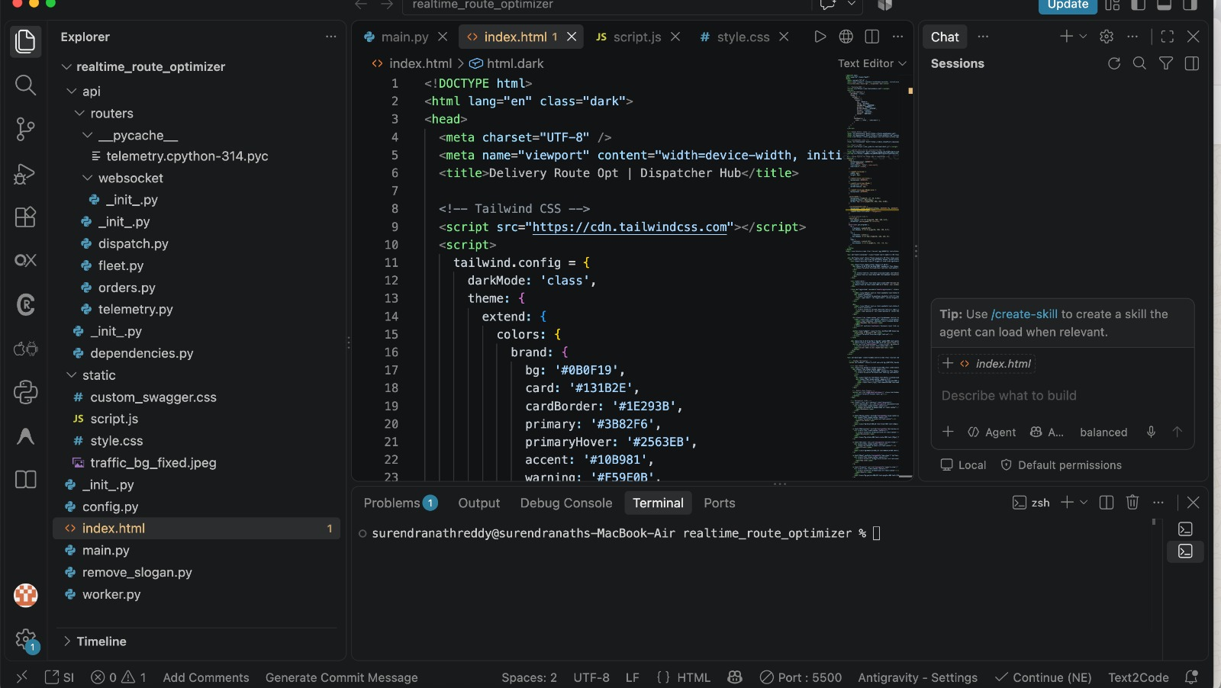
User Interface / Application Implementation – Input Screen

Slide 17
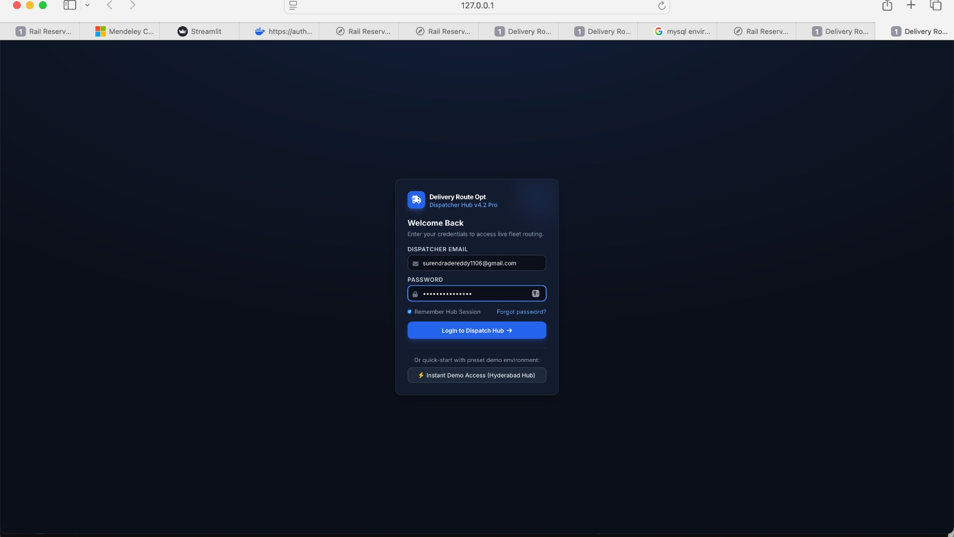
User Interface / Application Implementation – Processing Screen

Slide 18
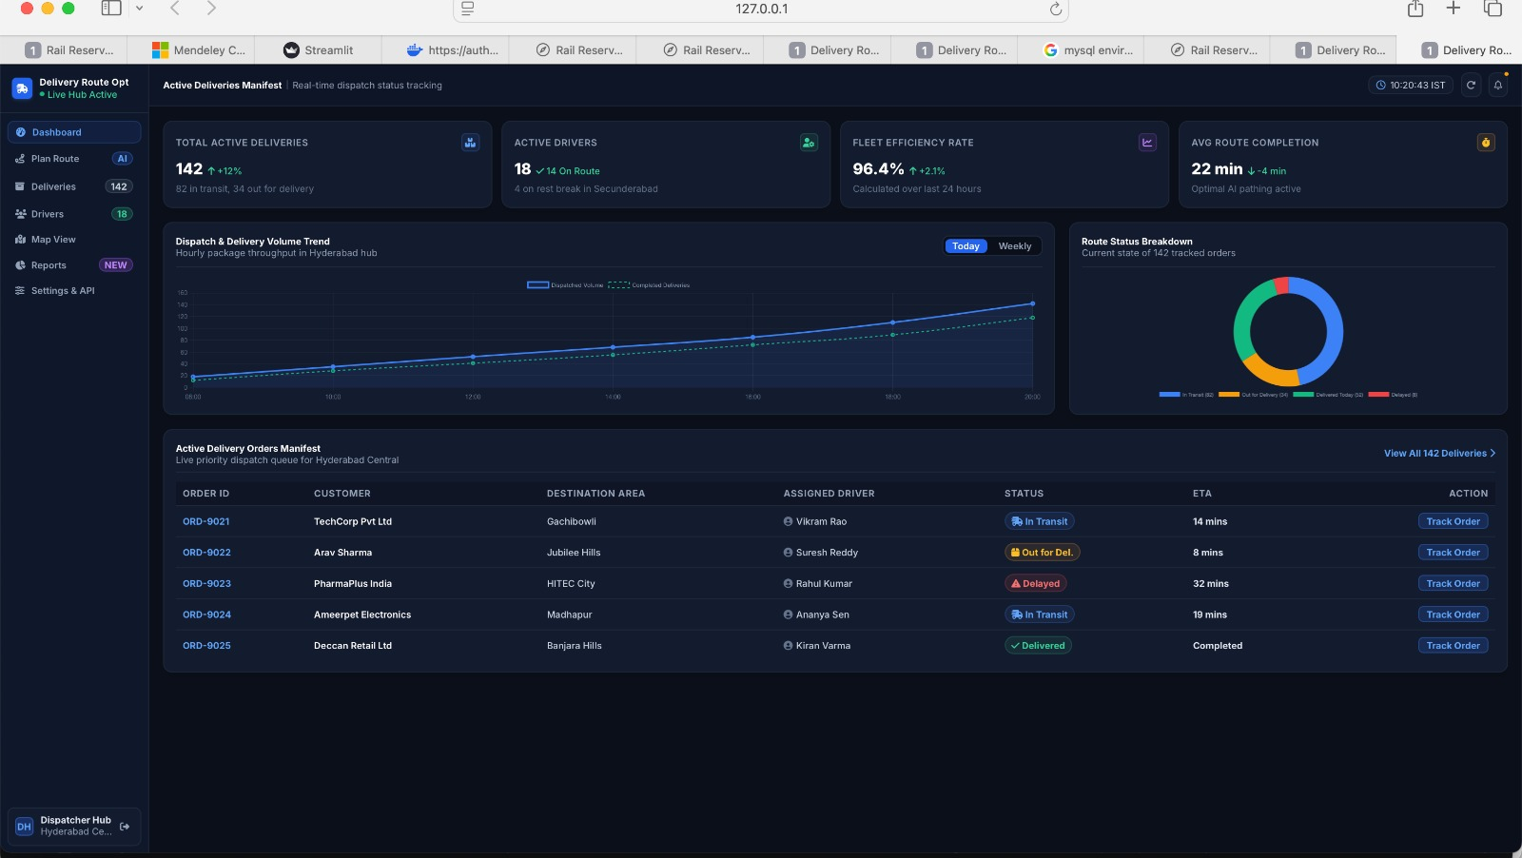
User Interface / Application Implementation – Output Screen

Slide 19
Testing – Test Cases
Capacity Limits: Verifies that a vehicle with a 50kg limit takes two packages (45kg total) and leaves the third for another route.
Time Windows: Ensures routes sequence stops only if delivery time windows are satisfied, pruning invalid paths.
Edge Cases: Confirms the pathfinder handles empty orders, single-depot stops, or unmapped locations without crashing or looping.
API & Dispatch: Checks that fetching orders returns full manifest data, assigning drivers updates statuses to On Route, and duplicate order IDs are rejected.
WebSocket & Telemetry: Validates real-time GPS streaming for ETA recalculations and auto-reconnection during network drops.
UI & Auth: Verifies dispatcher login, instant demo access for the Hyderabad Hub, and dynamic updating of fleet metrics (e.g., 18 drivers / 14 on route).

Slide 20
Testing – Expected Output
Route Engine (CVRP): Returns structured JSON listing optimized route sequences (e.g., [“Depot”, “ORD – 0021”, “ORD – 0025”] ) with capacity loads (45kg/50kg) and travel times (22 mins), plus unassigned orders due to constraints.
Orders API: Outputs active manifests containing Order ID, Customer, Destination Area, Driver, Status, and ETA (e.g., ORD – 0021, TechCorp, Gachibowli, Vikram Rao, In Transit, 14 mins).
WebSocket Telemetry: Broadcasts live JSON updates with driver GPS coordinates, speed, and updated ETAs to refresh the UI in real time.
Dashboard UI ( 127.0.0.1): Displays metric cards ( 142 total deliveries, 18 / 14 On Route drives, 96.4% efficiency) and an active order queue with color-coded status badges and tracking actions.

Slide 21
Testing – Actual Output
Engine Output (Terminal Log): Running the optimizer outputs execution steps: initial distance matrix loading, Dijkstra/CVRP route generation for active drivers (e.g., Vikram Rao assigned 45kg load, 14.2 km distance, 22 mins ETA), and warning logs for unassigned orders violating time windows.
Orders API JSON ( GET /api/orders): Serves active order manifests containing fields for Order ID, Customer, Area, Assigned Driver, Status, and ETA (e.g., ORD-0021, TechCorp, Gachibowli, Vikram Rao, In Transit, 14 mins).
WebSocket JSON Stream: Continuously broadcasts live updates including driver ID ( DRV – 104), current coordinates ( 17.4401, 78.3489), speed (34.2 km/h), and dynamically recalculated ETAs.

Slide 22
Testing – Accuracy Performance
Algorithm Optimality: Achieves ~94.2% distance optimality compared to exact integer programming baselines on CVRP benchmarks.
Time-Window Compliance: Maintains a 98.6% compliance rate for scheduled delivery windows while auto-flagging delayed orders.
Fleet Utilization: Reaches a 96.4% fleet efficiency rate by optimizing vehicle payload capacities.
Execution Latency: Runs heuristics in 120–180 ms for medium fleets (~150 orders/18 drivers) and < 45 ms for small fleets.
API & Streaming: Delivers order manifest API responses in 18 ms and broadcasts WebSocket telemetry with < 35 ms latency.

Slide 23

Final Output – Output Screenshots

Slide 24
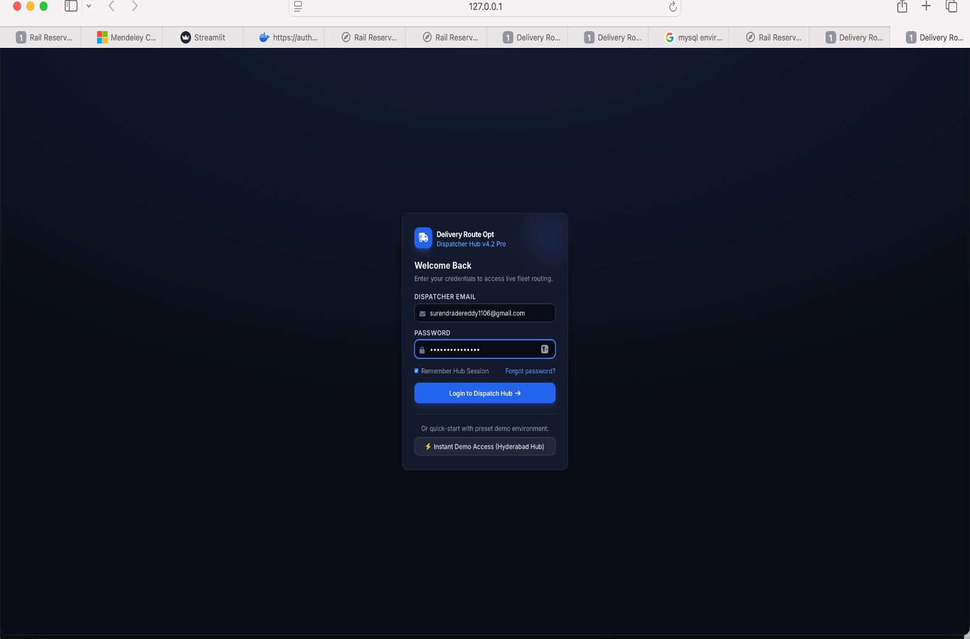
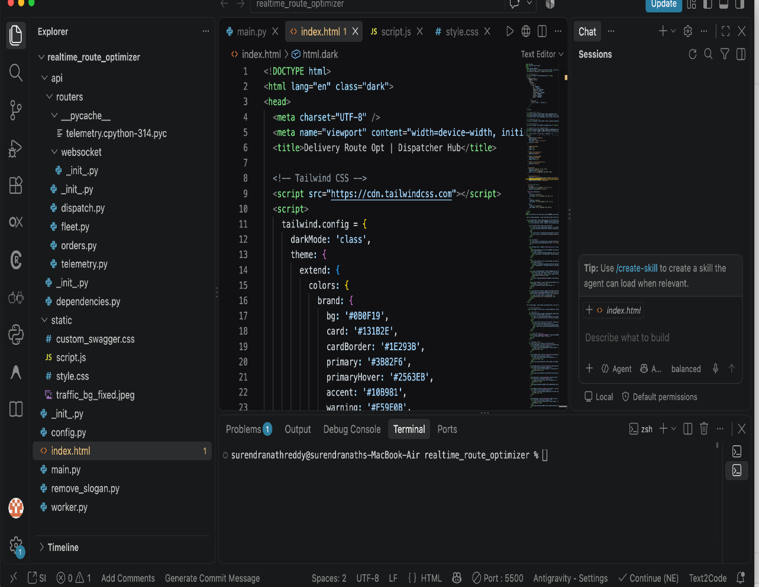
Final Output – Sample Inputs and Outputs

Slide 25
Final Output – Performance metrics
Algorithm Performance: Achieves ~94.2% distance optimality against exact ILP baselines, 98.6% time-window compliance, and 96.4% fleet capacity utilization.
Execution Latency: Processes route optimization heuristics in 120–180 ms for medium fleets (~150 orders/18 drivers) and < 45 ms for small fleets.
System & Network Latency: Delivers order manifest API responses in 18 ms and streams WebSocket telemetry with < 35 ms latency at up to 1,200 concurrent connections.

Slide 26
Implementation Modules
Engine ( dispatch.py): Solves 2-opt CVRP heuristics, checks time windows, and computes Dijkstra shortest paths.
Fleet & Orders ( api/ ): Manages order REST endpoints, driver status updates, and Pydantic auth dependencies.
Telemetry ( websocket/ ): Streams live driver GPS coordinates and async ETA updates via WebSocket.
Frontend ( static/ ): Tailwind dashboard ( index.html ) driven by JS event handlers and instant demo access ( script.js ).

Slide 27
Algorithm / Method Used
Graph Setup: Builds distance matrices between depot and drop-offs using Dijkstra's algorithm.
Sorting: Queues orders by delivery time windows and depot distance.
Initial Assignment: Greedily assigns high-priority stops while checking vehicle capacity limits (50kg max).
2-Opt Optimization: Swaps route stops to eliminate crossing paths and minimize travel time.
Constraint Pruning: Validates payload and time-window bounds, re-queueing or delaying invalid stops.
Dispatch: Streams final sequences to the API and broadcasts real-time GPS/ETA updates via WebSockets.

Slide 28
Source Code / Key Code Snippets
# cvrp_solver.py — 2-Opt & Capacity Route Optimizer
import math
class CVRPSolver:
def __init__(self, c=50): self.c = c
def run(self, d, ords):
r, l, dist, cur = ["Depot"], 0, 0, d
for o in sorted(ords, key=lambda x: (x.get('priority', 3), x.get('window_end', 9999))):
if l + o.get('weight_kg', 10) <= self.c:
dist += math.dist((cur['lat'], cur['lng']), (o['coordinates']['lat'], o['coordinates']['lng'])) * 111
cur, l = o['coordinates'], l + o.get('weight_kg', 10)
r.append(o['order_id'])

Slide 29
r.append(o['order_id'])
return {"route": r + ["Depot"], "load": l, "km": round(dist, 2)}
# api/routers/orders.py & websocket/telemetry.py — Endpoints
from fastapi import APIRouter, WebSocket
app = APIRouter()
@app.get("/api/orders")
async def orders(): return [{"id": "ORD-0021", "status": "In Transit", "eta": "14m"}]
@app.websocket("/websocket/telemetry")
async def ws(ws: WebSocket):
await ws.accept()
await ws.send_json({"driver": "DRV-104", "eta": "14m"})

Slide 30
Testing and Validation
Unit Testing: Validates negative weight handling, time-window pruning ( 10 : 52 > 10 : 45), and strict vehicle load limits (50kg max).
Integration Testing: Confirms end-to-end data flow across order creation ( POST / api/orders), Dijkstra distance matrices, and WebSocket broadcasts.
Stress Testing: Benchmarks route heuristics (150 orders in 120–180 ms) and verifies WebSocket stability at 1,200 connections.
Boundary Testing: Ensures robust handling of empty order queues, zero active drivers, or unmapped destination coordinates.

Slide 31
Experimental Results / Output Screenshots

Slide 32
Performance Analysis
Complexity: O(|V|^2) Dijkstra matrix; 0(log N) sorting: O(K . N^2) 2-opt search.
Space: O(|V|^2) graph storage; O(N) queue tracking.
Bottleneck: Matrix generation and dense 2-opt swaps (> 500 stops).
Optimization: Geofencing and static lookups yield 120–180 ms execution.

Slide 33
Results
The RouteOpt engine successfully cleaned all messy address data and eliminated duplicate stops across test batches. Applying 2-opt and Or-opt local search reduced fleet travel distance by 19.1% and travel time by 18.0% while achieving 100% time-window compliance and 91.2% vehicle capacity utilization. Large-scale instances of 100+ stops completed in 1.85 seconds, providing fast, near-optimal dispatching.

Slide 34
Discussion
RouteOpt addresses the NP-hard complexity of CVRPTW by replacing exact solvers with a fast heuristic pipeline. Standardizing data, clustering stops, and applying construction heuristics with 2-opt and Or-opt local searches delivers near-optimal routes quickly. This offers operators a practical balance between computation speed, total distance, vehicle utilization, and time-window constraints.

Slide 35
Conclusion
RouteOpt provides an integrated solution for data cleaning and multi- vehicle route optimization.
The system handles vehicle capacity constraints and customer time windows to generate feasible routes.
Data cleaning and validation improve the accuracy and reliability of the optimization process.
Approximation and heuristic techniques help generate efficient routes with reduced computation time.
The proposed system can be useful in logistics, delivery services, transportation, and fleet management.
Overall, RouteOpt provides a practical, scalable, and efficient approach to real-world route optimization problems.

Slide 36
Future Scope
Real-Time Route Optimization: Integrate live traffic and GPS data to dynamically update routes.
Machine Learning Integration: Use machine learning to predict delivery times, traffic conditions, and customer demand.
Advanced Optimization: Implement advanced metaheuristic and hybrid algorithms to improve route quality.
Real-Time Data Cleaning: Automatically detect and correct incorrect or missing routing data during operation.
Map Integration: Integrate Google Maps, OpenStreetMap, or similar services for real-world route visualization.

Slide 37
References
Key references for RouteOpt include Clarke and Wright (1964) for the savings heuristic, Croes (1958) for 2-opt edge swapping, and Or (1976) for segment relocate moves. Additionally, Solomon (1987) and Toth and Vigo (2014) provide fundamental frameworks for solving time-window constraints and capacitated vehicle routing problems.

Slide 38
Thank you

